Slide 1
Lecture 14 – Security Engineering
Part 1

Slide 2
Topics covered
Security engineering and security management
Security engineering concerned with applications; security management with infrastructure.
Security risk assessment
Designing a system based on the assessment of security risks.
Design for security
How system architectures have to be designed for security.

Slide 3
Security engineering
Tools, techniques and methods to support the development and maintenance of systems that can resist malicious attacks that are intended to damage a computer-based system or its data.
A sub-field of the broader field of computer security.
Assumes background knowledge of dependability and security concepts (Lecture 10) and security requirements specification (Lecture 12)

Slide 4
Application/infrastructure security
Application security is a software engineering problem where the system is designed to resist attacks.
Infrastructure security is a systems management problem where the infrastructure is configured to resist attacks.
The focus of this Lecture is application security.

Slide 5
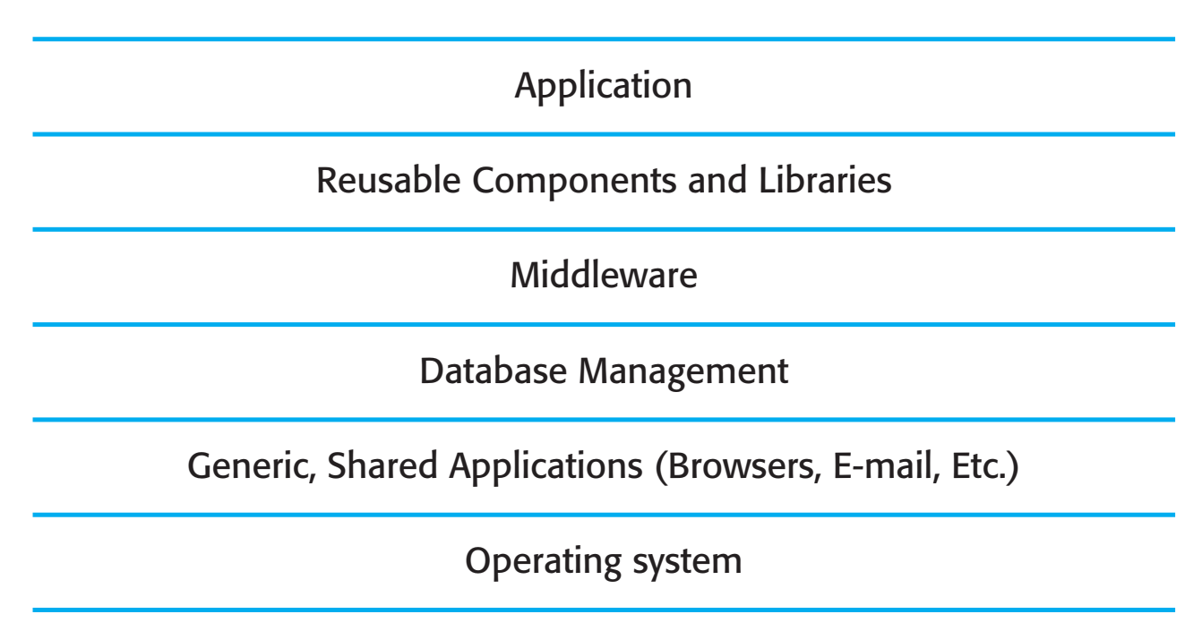
System layers where security may be compromised

Slide 6
System security management
User and permission management
Adding and removing users from the system and setting up appropriate permissions for users
Software deployment and maintenance
Installing application software and middleware and configuring these systems so that vulnerabilities are avoided.
Attack monitoring, detection and recovery
Monitoring the system for unauthorized access, design strategies for resisting attacks and develop backup and recovery strategies.

Slide 7
Security risk management
Risk management is concerned with assessing the possible losses that might ensue from attacks on the system and balancing these losses against the costs of security procedures that may reduce these losses.
Risk management should be driven by an organisational security policy.
Risk management involves
Preliminary risk assessment
Life cycle risk assessment
Operational risk assessment

Slide 8
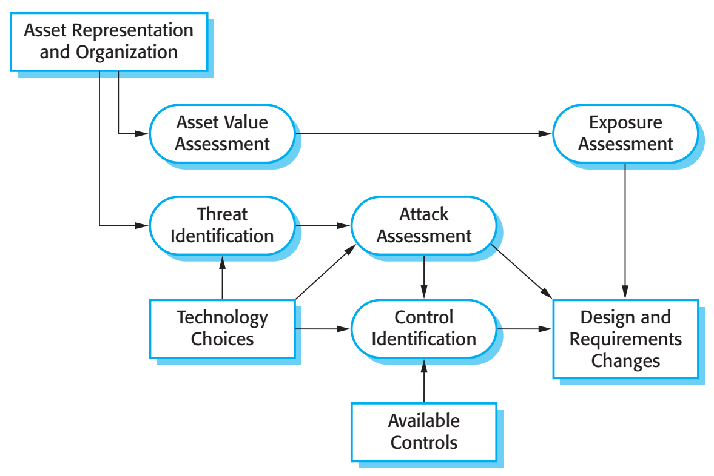
Preliminary risk assessment

Slide 9
Misuse cases
Misuse cases are instances of threats to a system
Interception threats
Attacker gains access to an asset
Interruption threats
Attacker makes part of a system unavailable
Modification threats
A system asset if tampered with
Fabrication threats
False information is added to a system

Slide 10
Asset analysis
Asset | Value | Exposure
The information system | High. Required to support all clinical consultations. Potentially safety-critical. | High. Financial loss as clinics may have to be canceled. Costs of restoring system. Possible patient harm if treatment cannot be prescribed.
The patient database | High. Required to support all clinical consultations. Potentially safety-critical. | High. Financial loss as clinics may have to be cancelled. Costs of restoring system. Possible patient harm if treatment cannot be prescribed.
An individual patient record | Normally low although may be high for specific high-profile patients. | Low direct losses but possible loss of reputation.

Slide 11
Threat and control analysis
Threat | Probability | Control | Feasibility
Unauthorized user gains access as system manager and makes system unavailable | Low | Only allow system management from specific locations that are physically secure. | Low cost of implementation but care must be taken with key distribution and to ensure that keys are available in the event of an emergency.
Unauthorized user gains access as system user and accesses confidential information | High | Require all users to authenticate themselves using a biometric mechanism. Log all changes to patient information to track system usage. | Technically feasible but high-cost solution. Possible user resistance. Simple and transparent to implement and also supports recovery.

Slide 12
Security requirements
Patient information must be downloaded at the start of a clinic session to a secure area on the system client that is used by clinical staff.
Patient information must not be maintained on system clients after a clinic session has finished.
A log on a separate computer from the database server must be maintained of all changes made to the system database.

Slide 13
Life cycle risk assessment
Risk assessment while the system is being developed and after it has been deployed
More information is available - system platform, middleware and the system architecture and data organisation.
Vulnerabilities that arise from design choices may therefore be identified.

Slide 14
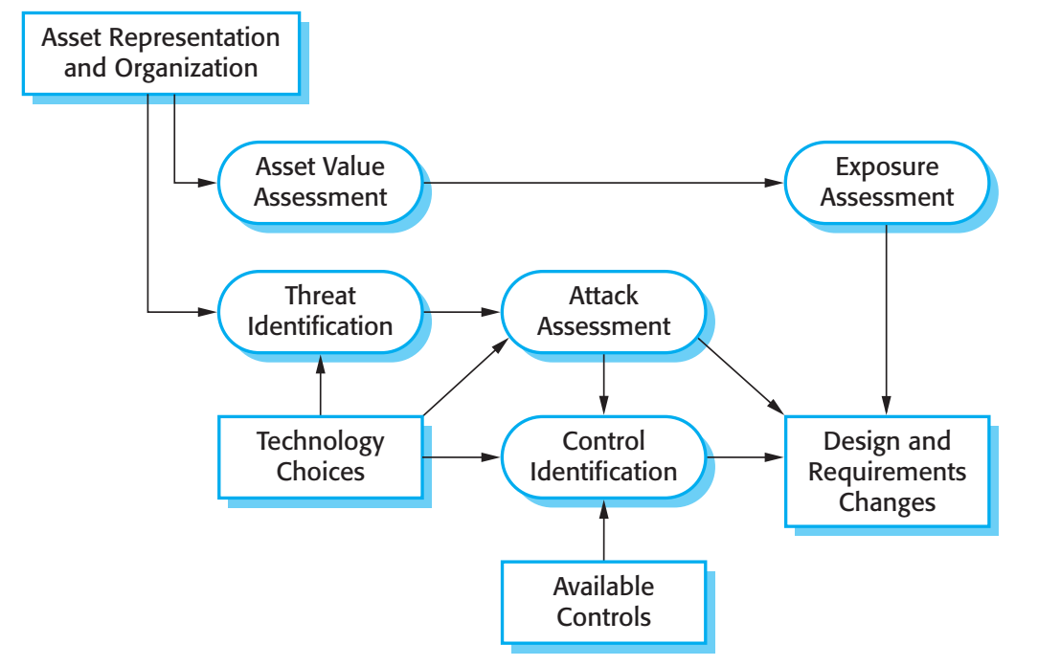
Life-cycle risk analysis

Slide 15
Design decisions from use of COTS
System users authenticated using a name/password combination.
The system architecture is client-server with clients accessing the system through a standard web browser.
Information is presented as an editable web form.

Slide 16
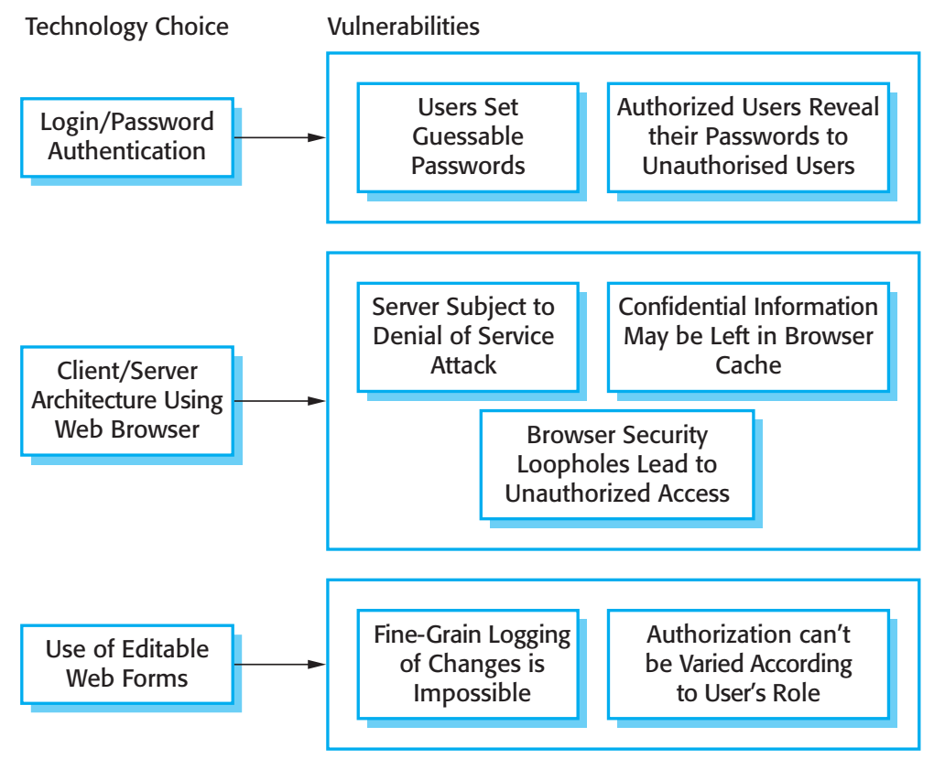
Vulnerabilities associated with technology choices

Slide 17
Security requirements
A password checker shall be made available and shall be run daily. Weak passwords shall be reported to system administrators.
Access to the system shall only be allowed by approved client computers.
All client computers shall have a single, approved web browser installed by system administrators.

Slide 18
Operational risk assessment
Continuation of life cycle risk assessment but with additional information about the environment where the system is used.
Environment characteristics can lead to new system risks
Risk of interruption means that logged in computers are left unattended.

Slide 19
Design for security
Architectural design
how do architectural design decisions affect the security of a system?
Good practice
what is accepted good practice when designing secure systems?
Design for deployment
what support should be designed into a system to avoid the introduction of vulnerabilities when a system is deployed for use?

Slide 20
Architectural design
Two fundamental issues have to be considered when designing an architecture for security.
Protection
How should the system be organised so that critical assets can be protected against external attack?
Distribution
How should system assets be distributed so that the effects of a successful attack are minimized?
These are potentially conflicting
If assets are distributed, then they are more expensive to protect. If assets are protected, then usability and performance requirements may be compromised.

Slide 21
Protection
Platform-level protection
Top-level controls on the platform on which a system runs.
Application-level protection
Specific protection mechanisms built into the application itself e.g. additional password protection.
Record-level protection
Protection that is invoked when access to specific information is requested
These lead to a layered protection architecture

Slide 22
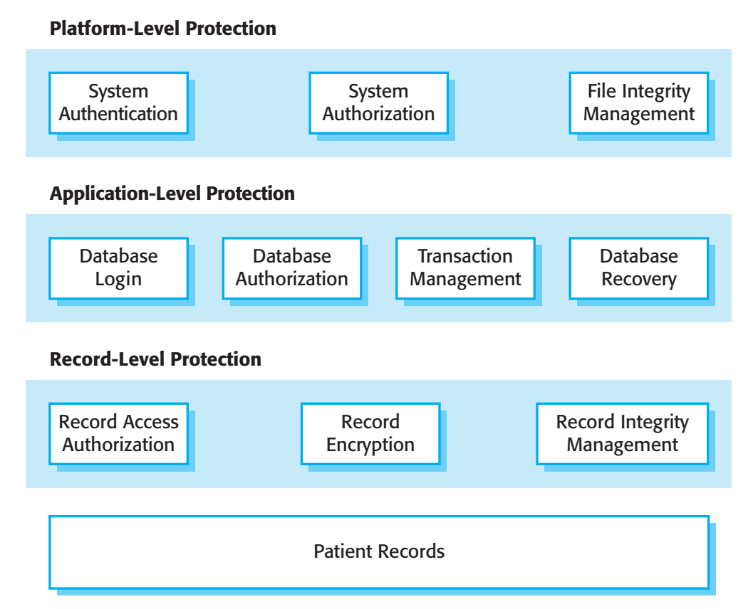
A layered protection architecture

Slide 23
Distribution
Distributing assets means that attacks on one system do not necessarily lead to complete loss of system service
Each platform has separate protection features and may be different from other platforms so that they do not share a common vulnerability
Distribution is particularly important if the risk of denial of service attacks is high

Slide 24
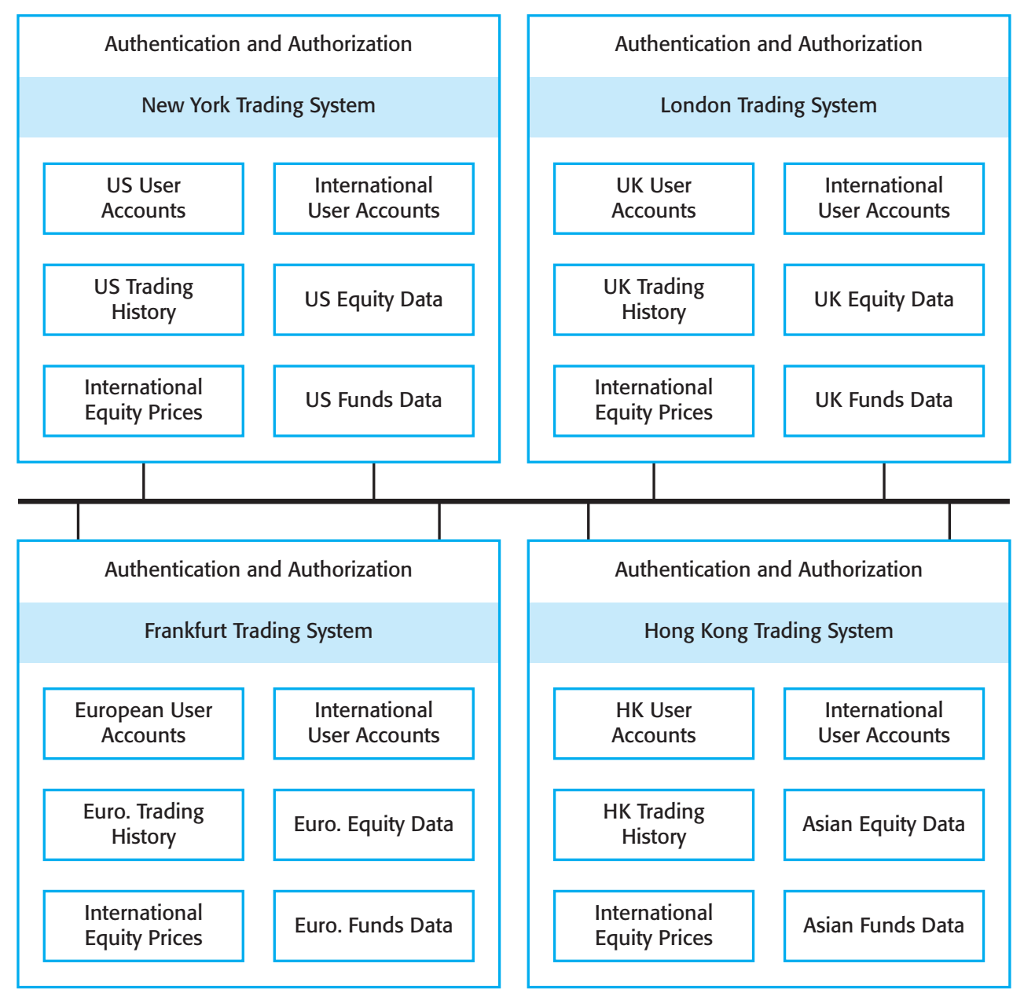
Distributed assets in an equity trading system

Slide 25
Key points
Security engineering is concerned with how to develop systems that can resist malicious attacks
Security threats can be threats to confidentiality, integrity or availability of a system or its data
Security risk management is concerned with assessing possible losses from attacks and deriving security requirements to minimise losses
Design for security involves architectural design, following good design practice and minimising the introduction of system vulnerabilities

Slide 26
Lecture 14 – Security Engineering
Part 2

Slide 27
Topics covered
Design guidelines for security
Guidelines that help you design a secure system
Design for deployment
Design so that deployment problems that may introduce vulnerabilities are minimized
System survivability
Allow the system to deliver essential services when under attack

Slide 28
Design guidelines for security engineering
Design guidelines encapsulate good practice in secure systems design
Design guidelines serve two purposes:
They raise awareness of security issues in a software engineering team. Security is considered when design decisions are made.
They can be used as the basis of a review checklist that is applied during the system validation process.
Design guidelines here are applicable during software specification and design

Slide 29
Design guidelines for secure systems engineering
Security guidelines
Base security decisions on an explicit security policy
Avoid a single point of failure
Fail securely
Balance security and usability
Log user actions
Use redundancy and diversity to reduce risk
Validate all inputs
Compartmentalize your assets
Design for deployment
Design for recoverability

Slide 30
Design guidelines 1-3
Base decisions on an explicit security policy
Define a security policy for the organization that sets out the fundamental security requirements that should apply to all organizational systems.
Avoid a single point of failure
Ensure that a security failure can only result when there is more than one failure in security procedures. For example, have password and question-based authentication.
Fail securely
When systems fail, for whatever reason, ensure that sensitive information cannot be accessed by unauthorized users even although normal security procedures are unavailable.

Slide 31
Design guidelines 4-6
Balance security and usability
Try to avoid security procedures that make the system difficult to use. Sometimes you have to accept weaker security to make the system more usable.
Log user actions
Maintain a log of user actions that can be analyzed to discover who did what. If users know about such a log, they are less likely to behave in an irresponsible way.
Use redundancy and diversity to reduce risk
Keep multiple copies of data and use diverse infrastructure so that an infrastructure vulnerability cannot be the single point of failure.

Slide 32
Design guidelines 7-10
Validate all inputs
Check that all inputs are within range so that unexpected inputs cannot cause problems.
Compartmentalize your assets
Organize the system so that assets are in separate areas and users only have access to the information that they need rather than all system information.
Design for deployment
Design the system to avoid deployment problems
Design for recoverability
Design the system to simplify recoverability after a successful attack.

Slide 33
Design for deployment
Deployment involves configuring software to operate in its working environment, installing the system and configuring it for the operational platform.
Vulnerabilities may be introduced at this stage as a result of configuration mistakes.
Designing deployment support into the system can reduce the probability that vulnerabilities will be introduced.

Slide 34
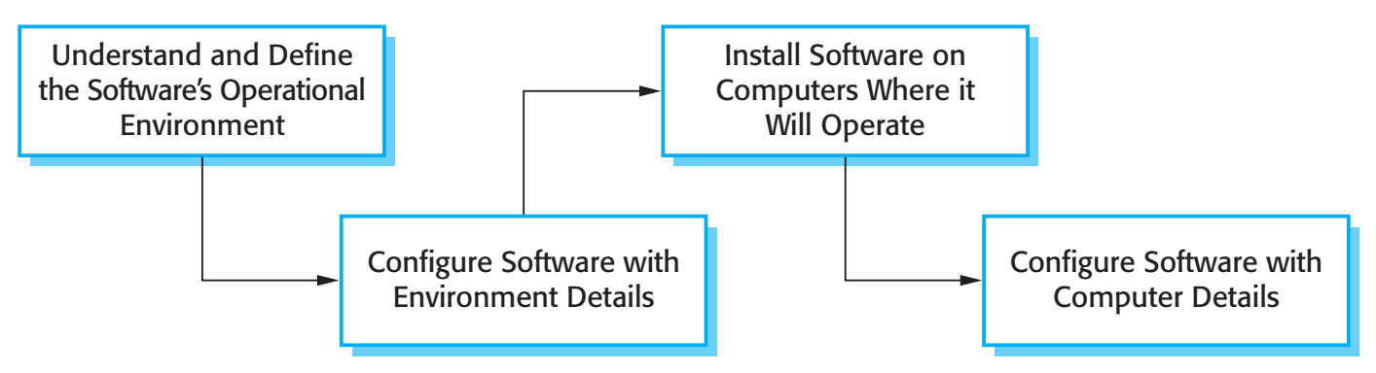
Software deployment

Slide 35
Configuration vulnerabilities
Vulnerable default settings
Attackers can find out the default settings for software. If these are weak (often to increase usability) then they can be exploited by users when attacking a system.
Development rather than deployment
Some configuration settings in systems are designed to support development and debugging. If these are not turned off, they can be a vulnerability that can be exploited by attackers.

Slide 36
Deployment support 1
Include support for viewing and analyzing configurations
Make sure that the system administrator responsible for deployment can easily view the entire configuration. This makes it easier to spot omissions and errors that have been made.
Minimize default privileges and thus limit the damage that might be caused
Design the system so that the default privileges for an administrator are minimized. This means that if someone gains admin access, they do not have immediate access to the features of the system.

Slide 37
Deployment support 2
Localize configuration settings
When setting up a system, all information that is relevant to the same part or component of a system should be localized so that it is all set up at once. Otherwise, it is easy to forget to set up related security features.
Provide easy ways to fix security vulnerabilities
When problems are detected, provide easy ways, such as auto-updating, to repair security vulnerabilities in the deployed systems.

Slide 38
System survivability
Survivability is an emergent system property that reflects the systems ability to deliver essential services whilst it is under attack or after part of the system has been damaged
Survivability analysis and design should be part of the security engineering process

Slide 39
Importance of survivability
Our economic and social lives are dependent on computer systems
Critical infrastructure – electricity, gas, telecommunications, transport
Healthcare
Government
Loss of business systems for even a short time can have very severe economic effects
Airline reservation systems
E-commerce systems
Payment systems

Slide 40
Service availability
Which system services are the most critical for a business?
How might these services be compromised?
What is the minimal quality of service that must be maintained?
How can these services be protected?
If a service becomes unavailable, how quickly can it be recovered?

Slide 41
Survivability strategies
Resistance
Avoiding problems by building capabilities into the system to resist attacks
Recognition
Detecting problems by building capabilities into the system to detect attacks and failures and assess the resultant damage
Recovery
Tolerating problems by building capabilities into the system to deliver services whilst under attack

Slide 42
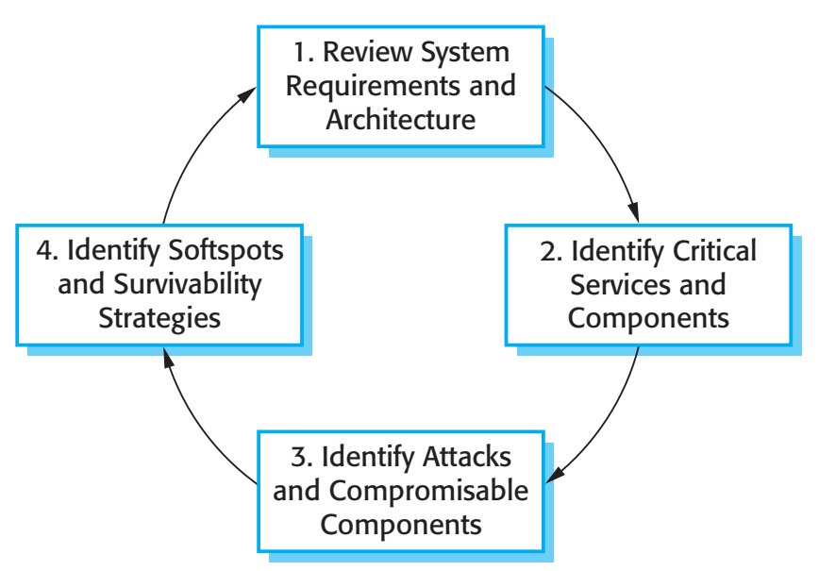
Stages in survivability analysis

Slide 43
Key activities
System understanding
Review golas, requirements and architecture
Critical service identification
Identify services that must be maintained
Attack simulation
Devise attack scenarios and identify components affected
Survivability analysis
Identify survivability strategies to be applied

Slide 44
Trading system survivability
User accounts and equity prices replicated across servers so some provision for survivability made
Key capability to be maintained is the ability to place orders for stock
Orders must be accurate and reflect the actual sales/purchases made by a trader

Slide 45
Survivable ordering service
The critical service that must survive is the ability for authorized users to place orders for stock
This requires 3 components of the system to be available and operating reliability:
User authentication, allowing authorized users to log on to the system
Price quotation, allowing buying and selling prices to be quoted
Order placement, allowing buy and sell orders to be made

Slide 46
Possible attacks
Malicious user masquerades as a legitimate user and places malicious orders for stock, with the aim of causing problems for the legitimate user
An unauthorized user corrupts the database of transactions thus making reconciliation of sales and purchases impossible

Slide 47
Survivability analysis in an equity trading system
Attack | Resistance | Recognition | Recovery
Unauthorized user places malicious orders | Require a dealing password that is different from the login password to place orders. | Send copy of order by e-mail to authorized user with contact phone number (so that they can detect malicious orders). Maintain user’s order history and check for unusual trading patterns. | Provide mechanism to automatically ‘undo’ trades and restore user accounts. Refund users for losses that are due to malicious trading. Insure against consequential losses.
Corruption of transactions database | Require privileged users to be authorized using a stronger authentication mechanism, such as digital certificates. | Maintain read-only copies of transactions for an office on an international server. Periodically compare transactions to check for corruption. Maintain cryptographic checksum with all transaction records to detect corruption. | Recover database from backup copies. Provide a mechanism to replay trades from a specified time to re-create the transactions database.

Slide 48
Key points
General security guidelines sensitize designers to security issues and serve as review checklists
Configuration visualization, setting localization, and minimization of default privileges help reduce deployment errors
System survivability reflects the ability of a system to deliver services whilst under attack or after part of the system has been damaged.

